Slide 1
Airline reservation system
Presented By: Snehal Ganesh Rakhonde
Guided By: Prof. Indrakka Mali

Slide 2
CONTENTS
Introduction
Tables Structure
Work Flow
conclusion

Slide 3
introduction
Airline Reservation System is an application where users can book flight tickets, cancel their tickets from the list of flights.
This project implements CRUD operations and association between two tables on the database.
The tables flight and user both are associated to booking table as one to many.
It uses JDBC(Java Data Base Connectivity) to interact with the database.
Unregistered users need to register to make a booking.

Slide 4
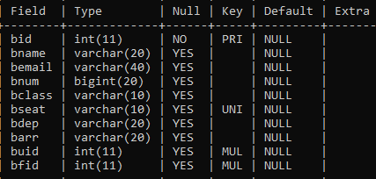
Table structure
Booking Table

Slide 5
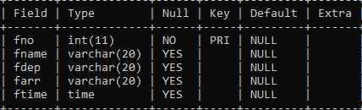
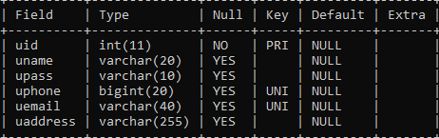
Flight Table
User Table

Slide 6
WORK FLOW
The project starts with asking the user if he/she wants to register or login.
For the users to make a booking there must be some flights in the flight table and the user must be registered i.e. the user record must be present in the user table.
If the user chooses to register, it asks the user to enter the user details which are then saved in the user table.
If the user chooses to login, it asks the user to enter their email and password.
If the credentials are incorrect a suitable message is displayed else it asks the user if he/she wants to make a booking or cancel a previously booked ticket.

Slide 7
If the user chooses to make a booking, it asks the user to enter the passenger details and departure and arrival location.
It displays the list of flights running between the two destinations.
The user needs to choose the suitable flight time.
The booking is made and record is stored in the booking table with respective user id and flight id.
If the user chooses to cancel a booking, it asks the user to enter the booking id.
If there exists a booking with the given id, the flight is cancelled, else a suitable message is displayed.

Slide 8
Once the booking or cancellation is done, it again asks the user if he/she wants to continue or not.
If yes, it again follows the same process, if not the program is terminated.

Slide 9
conclusion
Performing CRUD operations on the database.
Implement JDBC.
Association between tables.

Slide 10
Thank You

